Slide 1






Introduction to Modeling
Model Calibration and Verification
Basic Measurement and Unit
Conservation of Mass and Mass Balance

Slide 2
What is a model?

Slide 3


What is a model?
A model is defined as (EPA, 2009):
“ A simplification of reality that is constructed to gain insights into select attributes of a physical, biological, economic, or social system. A formal representation of the behavior of system processes, often in mathematical or statistical terms. The basis can also be physical or conceptual. ”

Slide 4
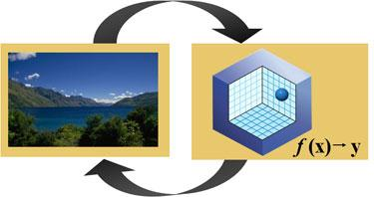
What is a model?
Models are representations of the environment that can be used to inform regulation or management decisions.

Slide 5
Types of model

Slide 6
Types of Models
Computational models
Conceptual models
Physical models
Analogous Models

Slide 7
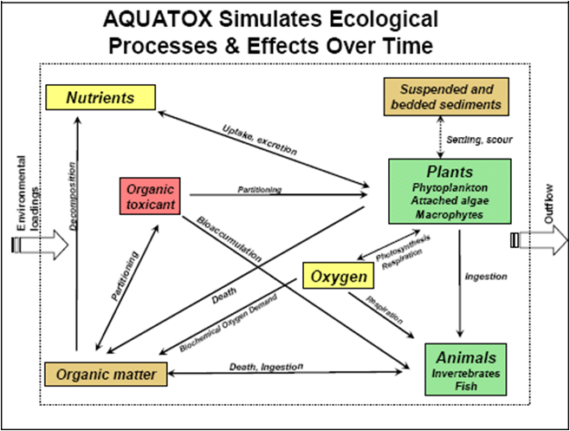
Types of Models
Conceptual models
A hypothesis regarding the important factors that govern the behavior of an object or process of interest.
Can be an interpretation or working description of the characteristics and dynamics of a physical system.

Slide 8
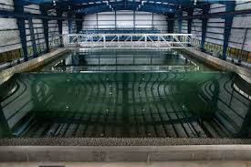
Types of Models
Physical models
https://www.youtube.com/watch?v=pxWsw--tLf0
https://www.youtube.com/watch?v=SzR46EHsl5w

Slide 9

Types of Models
Analogous models
When nonhuman species are used to demonstrate the potential health effects of chemicals on humans.
A mouse can serve as an analogous model of human physiology.

Slide 10


Types of Models
Computational models
Analytical models are special computational models that can be solved mathematically in terms of analytical functions.
Mathematical Models solved using computer

Slide 11
Computational Models
Empirical vs. Mechanistic models
Deterministic vs. Probabilistic models
Dynamic vs. Static models

Slide 12
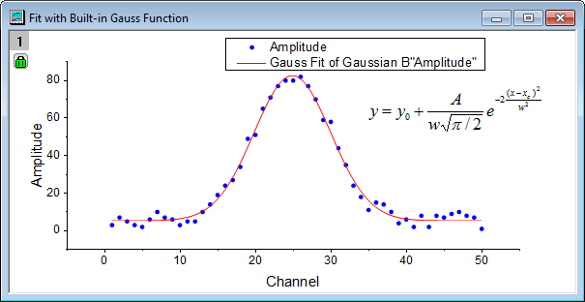
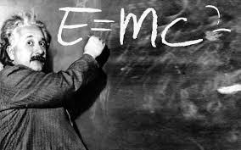
1. Empirical vs. Mechanistic
Empirical models
very little info on underlying mechanism.
rely on observed relationships among experimental data.
‘best-fit’ model.
Mechanistic models
explicitly include mechanisms/processes between state variables.
parameters supported by data and have real-world interpretations.

Slide 13
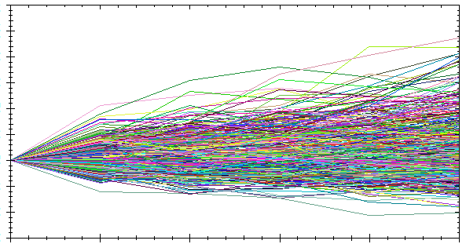
2. Deterministic vs. Probabilistic
Deterministic models
provide solution of state variable
do not explicitly simulate data ‘uncertainty’.
repeated simulation ⇒ consistent results.
Probabilistic models
Statistical/stochastic models.
evaluate impact of variability and uncertainty in various input parameters.

Slide 14
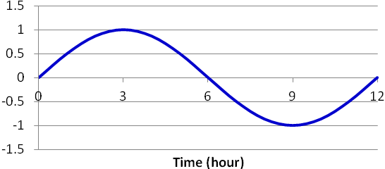
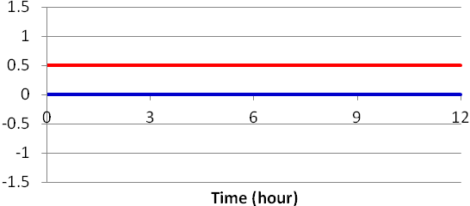
2. Dynamic vs. Static
Dynamic models
changes with time or space.
For most situations, where a differential equation is being approximated, the simulation model will use a finite time step (or spatial step) to estimate changes in state variables over time (or space).
Static models
make predictions about the way a system changes as the value of an independent variable changes.

Slide 15


1.1 Introduction
Mathematical model:
represents a simplified version of reality;
idealized formulation representing response of a physical system to external stimuli.
exercise
food
stress
illness

Slide 16
1.1 Introduction
Mathematical model:
represents a simplified version of reality.
idealized formulation representing response of a physical system to external stimuli.
covers broad range of topics in various disciplines.

Slide 17
1.1 Introduction
Environmental Modeling.
The term environment covers a myriad of possible systems and processes, including land, ocean and atmospheric based systems.
Specifically water quality modeling.

Slide 18
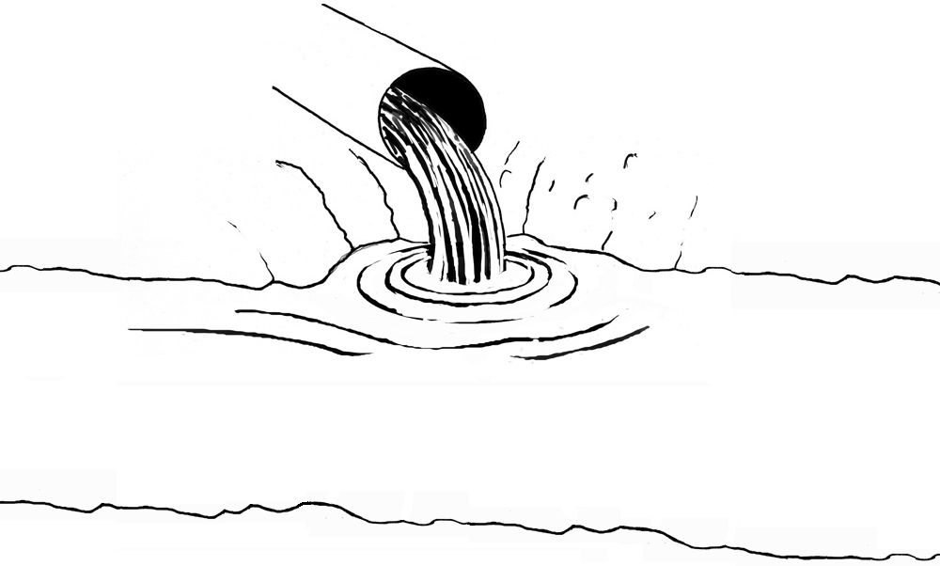
Water Quality (WQ) Model
Built generally for the following reasons:
To gain a better understanding of the fate and transport of chemicals by quantifying their reactions, speciation and movement.
To determine chemical exposure concentrations to aquatic organisms and/or humans in the past, present or future.
To predict future conditions under various loading scenarios or management action alternatives.

Slide 19
Water Quality (WQ) Model
To gain a better understanding of the fate and transport of chemicals by quantifying their reactions, speciation and movement.
Could provide answer to the questions:
Where do all the pollutants go?
Are they with us forever?
How rapidly are they degraded?
Related to the fate, transport and persistence of pollutants in the environment.

Slide 20
Water Quality (WQ) Model
To determine chemical exposure concentrations to aquatic organisms and/or humans in the past, present or future.
Safe level of frequency and duration of exposure to the chemical pollutants;
Pertains to assessing environmental risk and impact.

Slide 21
Water Quality (WQ) Model
To predict future conditions under various loading scenarios or management action alternatives.
Assess potential concentrations;
Under various loading scenarios;
Or management action alternatives.
Regardless of availability of monitoring data;
Always desirable to have estimate of concentrations under various conditions.

Slide 22
Water Quality (WQ) Model
Important:
No existing mathematical models provide a perfectly accurate and complete picture of reality.
Tradeoffs: accuracy, flexibility and cost;
Offer important insights and info;
About the nature and scope of a problem;
And can inform solutions.

Slide 23
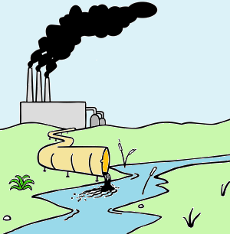
Water Quality (WQ) Model
Four ingredients are necessary:
Field data on chemical concentrations and mass discharge inputs;
A mathematical formulation;
Rate constants and equilibrium coefficients for the mathematical model;
Some performance criteria with which to judge the model.

Slide 24
1.2 Model Calibration and Verification
Field data are needed for model calibration and verification;
Depending on the ultimate use of the model;
Amount of field reconnaissance varies;
Model for regulatory purposes;
Should have enough field data to be confident of the model results.

Slide 25
1.2 Model Calibration and Verification
This requires two sets of field measurements;
One for model calibration ;
One for verification under different circumstances;
Comparison between simulation results and field measurements;
Coefficients and rate constants from literature or laboratory studies;
Flow discharge rates as input to drive model;

Slide 26
1.2 Model Calibration and Verification
Statistical comparison between the model results and field measurements;
If errors are not acceptable, tune the model to obtain an acceptable simulation;
Model tuning = systematically varies rate constants and coefficients;
Within the range of experimentally determined values reported in the literature.
Thus the model is calibrated.

Slide 27
1.2 Model Calibration and Verification
Use coefficients and rate constants from literature to obtain model result.
Tune model to obtain a better fit.
Get a set of field measurements.
R² = 0.70
R² = 0.99
∴Model is calibrated

Slide 28
1.2 Model Calibration and Verification
R² = 0.99
∴Model is verified

Slide 29
Definitions for Model Calibration and Verification
Mathematical model – a quantitative formulation of chemical, physical and biological processes that simulates the system.
State variable – the dependent variable that is being modeled (in this context, usually a chemical concentration).
Model parameters – coefficients in the model that are used to formulate the mass balance equation (e.g. rate constants, equilibrium constants)
State variable
Model parameters

Slide 30
Definitions for Model Calibration and Verification
Model inputs – forcing functions or constants required to run the model (e.g. flow rate, input chemical concentrations).
Calibration – a statistically acceptable comparison between model results and field measurements; adjustment or “tuning” of model parameters is allowed within the range of experimentally determined values reported in the literature.

Slide 31
Definitions for Model Calibration and Verification
Verification – a statistically acceptable comparison between model results and a second (independent) set of field data for another year or at an alternate site; model parameters are fixed and no further adjustment is allowed after the calibration step.
Simulation – use of model with any input data set (even hypothetical input) and not requiring calibration or verification with field data.

Slide 32
Definitions for Model Calibration and Verification
Validation – scientific acceptance that (1) the model includes all major and salient processes, (2) the processes are formulated correctly and (3) the model suitably describes observed phenomena for the use intended.
Robustness – utility of the model established after repeated applications under different circumstances and at different sites.

Slide 33
Definitions for Model Calibration and Verification
Post audit – a comparison of model predictions to future field measurements at that time.
Sensitivity analysis – determination of the effect of a small change in model parameters on the results (state variable), either by numerical simulation or mathematical techniques.

Slide 34
Definitions for Model Calibration and Verification
Uncertainty analysis – determination of the uncertainty (standard deviation) of the state variable expected value (mean) due to uncertainty in model parameters, inputs, or initial state via stochastic modeling techniques.

Slide 35
1.2 Model Calibration and Verification
How “good” the model results are depends on desired use of the model or predictions;
Criteria for acceptance of calibration or verification depend on intended use of model;
Acceptance of a model calibration or verification does not necessarily imply that the model, itself, is validated.

Slide 36
1.2 Model Calibration and Verification
It is possible that the model works well under one set of circumstances but poorly under another;
As the model is applied to different situations at various locations, we gain confidence in the model and its robustness;
Repeated model testing is crucial to gaining confidence in the model and to understanding its limitations.

Slide 37
1.3 Basic Measurement and Unit
Understanding basic measurement and unit;
An important aspect of math. modeling;
A unit is necessary to communicate values of that physical quantity;
Communicating a measurement without a unit is impossible because a measurement cannot be described without a reference used to make sense of the value given.

Slide 38
Table 1.1 Basic measurement and unit in SI (M = mass, L = length, T = time)
Measurement | Dimension | Unit | Measurement | Dimension | Unit
Length | L | m | Time | T | s
Area | L² | m² | Conc. | M L⁻³ | kg/m³ , kgm⁻³
Volume | L³ | m³ | Loading | M T⁻¹ | kg/s
Mass | M | kg | Kinetic rate | T⁻¹ | s⁻¹

Slide 39
Table 1.2 Some common unit conversions
Measurement | Conversion
Length | 1 km = 10³ m
 | 1 m = 10² cm
 | 1 cm = 10 mm
 | 1 m = 3.28 ft
Volume | 1 m³ = 1000 L
 | 1 L = 1000 mL
Mass | 1 kg = 1000 g
 | 1 g = 1000 mg
 | 1 kg = 2.2 lbs

Slide 40
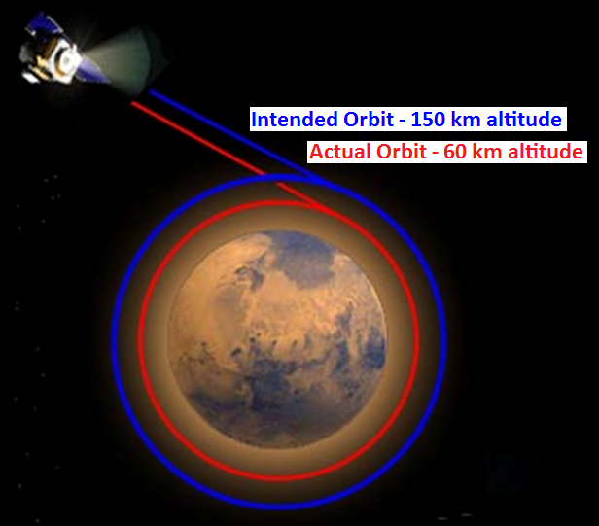
Infamous Unit Conversion Errors
On September 23, 1999 NASA lost the $125 million Mars Climate Orbiter spacecraft after a 286-day journey to Mars. Miscalculations due to the use of English units instead of metric units apparently sent the craft slowly off course -- 60 miles in all. Thrusters used to help point the spacecraft had, over the course of months, been fired incorrectly because data used to control the wheels were calculated in incorrect units. Lockheed Martin, which was performing the calculations, was sending thruster data in English units (pounds) to NASA, while NASA's navigation team was expecting metric units (Newtons).

Slide 41
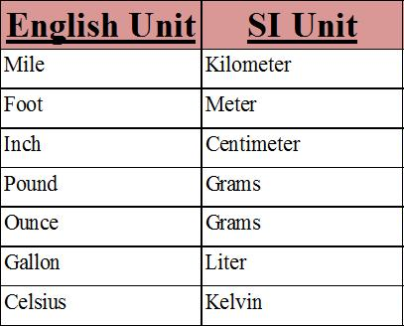
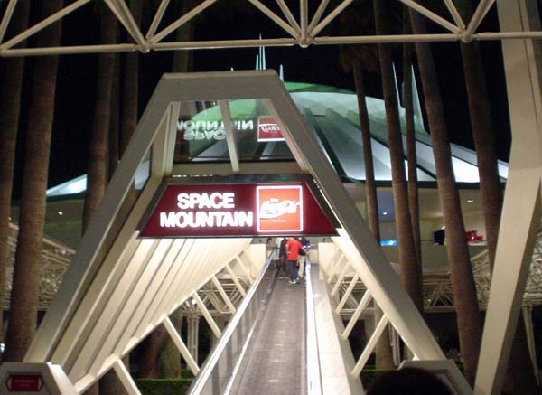
Infamous Unit Conversion Errors
On January 26, 2004 at Tokyo Disneyland's Space Mountain, an axle broke on a roller coaster train mid-ride, causing it to derail. The cause was a part being the wrong size due to a conversion of the master plans in 1995 from English units to Metric units. In 2002, new axles were mistakenly ordered using the pre-1995 English specifications instead of the current Metric specifications.

Slide 42
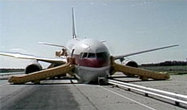
Infamous Unit Conversion Errors
On 23 July 1983, Air Canada Flight 143 ran completely out of fuel about halfway through its flight from Montreal to Edmonton. Fuel loading was miscalculated through misunderstanding of the recently adopted metric system. For the trip, the pilot calculated a fuel requirement of 22,300 kilograms, and they wanted to know how much in liters should be pumped. They used 1.77 as their density ratio in performing their calculations. However, 1.77 was given in pounds per liter, not kilograms per liter. The correct number should have been 0.80 kilograms/liter; thus, their final figure accounted for less than half of the necessary fuel.

Slide 43
1.3 Basic Measurement and Unit
Units can only be added or subtracted if they are the same type;
But it can always be multiplied or divided;
A physical value can be expressed in various units;
E.g., measurement of length can be expressed in meter (m) or centimeter (cm), among others.
Conversion of units is required to compare physical quantities in different units.

Slide 44

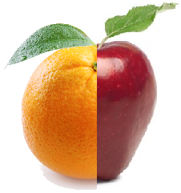
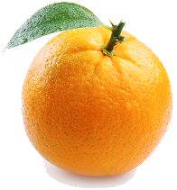
Example 1.1(a)
What do we have if we add 1 km to 3 kg?
We cannot add items of different measurements.
+
≠
=
?

Slide 45
Example 1.1(b)
Box A has an area of 25 cm² and a height of 4 cm. Box B has a volume of 80. Which one of these boxes has a larger volume?
Height =
4 cm
Volume = 80
Area =
25 cm²
A
B
cm³
Box A volume = 25 × 4 = 100 cm³.
Box B unit is not given and hence, we cannot compare between Box B volume and Box A volume.
If Box B volume is 80 cm³, then Box A has a larger volume.

Slide 46
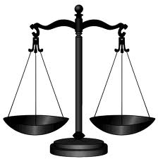
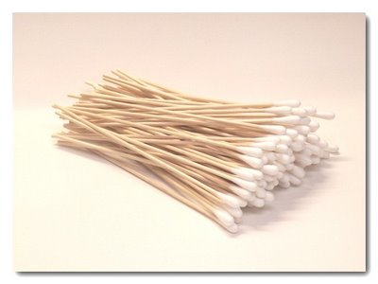

Example 1.1(c)
Between 2.2 pounds of iron rods and 1 kg of cotton buds, which one of these is heavier?
Both are of the same weight.
2.2 pounds = 1 kg

Slide 47

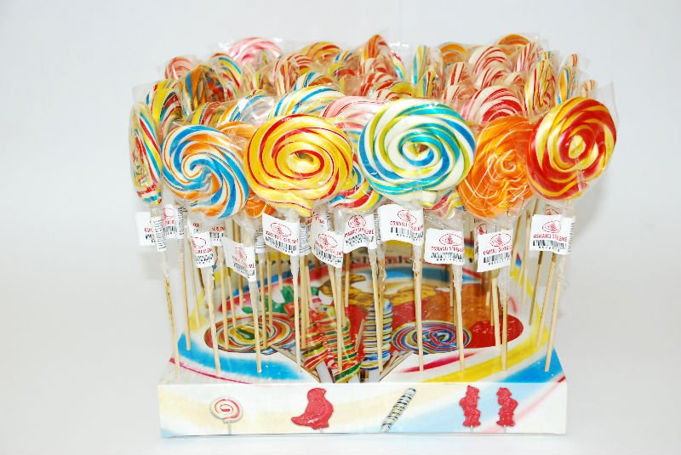
Example 1.1(d)
Lina has a 300 g packet of jelly beans and 0.25 kg of lollipops for her kid’s birthday party. What is the total weight of the sweet treats that she has for the party?
Lollipops = 0.25 kg
Jelly beans = 300 g
Lollipops = 0.25 kg = 0.25 × 1000 g = 250 g
Total weight = 550 g or 0.55 kg.

Slide 48
Example 1.1(e)
Convert kg/m³ to mg/L.
1 kg = 10⁶ mg
1 m³ = 10³ L
∴ 1 kg/m³ = 10⁶/10³ mg/L
= 1000 mg/L

Slide 49
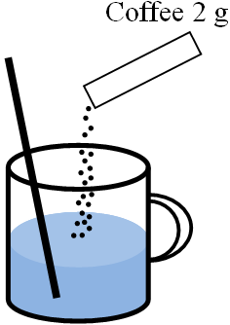

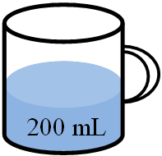
Example 1.2
Consider a cup with 200 mL of water.
Two grams of coffee powder from a sachet is added to the cup of water.
After stirring the beverage, find the concentration of coffee in kg/m³ in that cup of water.
10 kg/m³

Slide 50

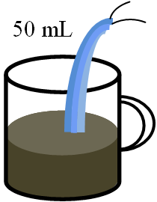
Example 1.2
The color of the beverage indicates that the coffee may be too strong.
Therefore, another 50 mL of water is added into the beverage.
After stirring the beverage, find the diluted concentration of coffee in kg/m³ in that cup of water.
8 kg/m³

Slide 51

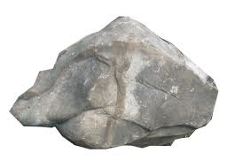
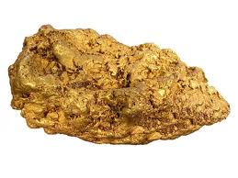
1.4 Conservation of Mass and the Mass Balance
To model aquatic channel systems;
We begin with a simple mass balance based upon the principle of continuity:
Matter is neither created nor destroyed in macroscopic chemical, physical and biological interactions.

Slide 52
1.4 Conservation of Mass and the Mass Balance
In quantitative terms, the principle is expressed as a mass-balance equation;
Accounts for all transfers of matter across the system’s boundaries and all transformations occurring within the system;
For a finite period of time,
Accumulation = loadings ± transport ± reactions
For situations where more than two substances interact, additional equations could be written.

Slide 53
1.4 Conservation of Mass and the Mass Balance
Accumulation = loadings ± transport ± reactions
Figure 1.1 Schematic representation of the loading, transport and reaction of a substance moving though and reacting within a volume of water.

Slide 54
1.4 Conservation of Mass and the Mass Balance
System can then be divided into subvolumes;
Levels of substances at various locations within the volume;
Math. division of space and matter into compartments = segmentation;
Fundamental to the application of mass conservation to water quality problems;
Concept of segmentation will be discussed later.

Slide 55
1.4 Conservation of Mass and the Mass Balance
Conservation of mass and the mass balance in simpler systems;
Control volume (water body) in form of a tank.
V - volume
C - concentration
Figure 1.2 Static mixing

Slide 56
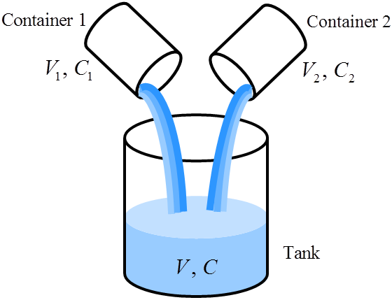
1.4 Conservation of Mass and the Mass Balance
Volume V and concentration C after mixing of the two liquids in the tank can be determined;
Measurement units being used:
meter (m) for length, kilogram (kg) for mass and second (s) for time;
Area = m², volume = m³;
concentration = kg/m³;

Slide 57
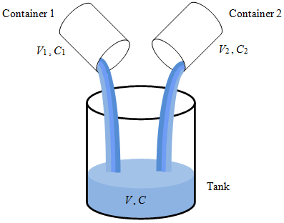
1.4 Conservation of Mass and the Mass Balance
The law of conservation of volume states that the total volume V after mixing is
(1.1)

Slide 58
1.4 Conservation of Mass and the Mass Balance
Masses M₁ and M₂ for both liquids are M₁= C₁V₁ and M₂= C₂V₂ kg
Concentrations C₁ and C₂ in kg/m³ (or kgm⁻³);
Law of conservation of mass states that the total mass M of the mixture is conserved as
(1.2)
(1.3)

Slide 59
1.4 Conservation of Mass and the Mass Balance
Here, C is the concentration of the liquid in the tank after complete mixing.
(1.1)
(1.3)
(1.4)

Slide 60
1.4 Conservation of Mass and the Mass Balance
In short, the liquid concentration C after complete mixing is given by
(1.5)

Slide 61
1.4 Conservation of Mass and the Mass Balance
Equation (1.1) states that volume is conserved;
Equation (1.2) states that mass is conserved;
Complete mixing process is in static state;
Indicating that steady state has been achieved;
After complete mixing, the state of the liquid no longer depends on time;
i.e. volume V, mass M and concentration C do not change from time to time.

Slide 62
1.4 Conservation of Mass and the Mass Balance
On contrary, if the state of the liquid changes with time, then we called this a dynamic state;
Dynamic mixing process will be discussed next with time dependency emphasized by the notation (t), e.g. V (t) and C (t).

Slide 63
1.4 Conservation of Mass and the Mass Balance
Suppose at time t sec, liquid in a tank has a volume of V m³ and concentration C kg/m³;
Liquid flows into this tank at the flow rate of Q₁ m³/s and with a concentration of C₁ kg/m³;
Liquid also
flows out of this tank
at the flow rate of Q₂ m³/s and concentration
of C₂ kg/m³.
Figure 1.3 Dynamic mixing

Slide 64
1.4 Conservation of Mass and the Mass Balance
Laws of conservation of mass and volume are used to obtain the formulations of volume V and concentration C of the liquid in the tank;
Both variables V and C are time dependent, i.e.
To find V (t) and C (t) , we observe what happen in a short time step Δt.

Slide 65
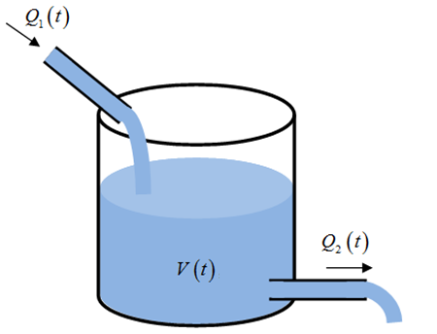
1.4 Conservation of Mass and the Mass Balance
ΔV = change in volume within Δt
ΔM = change in mass within Δt
Volume flowing into tank:
Q₁Δt m³
Volume flowing out of tank:
Q₂Δt m³
∴ law of conservation of volume:
(1.6)

Slide 66
1.4 Conservation of Mass and the Mass Balance
Taking that Δt → 0:
(1.7)

Slide 67
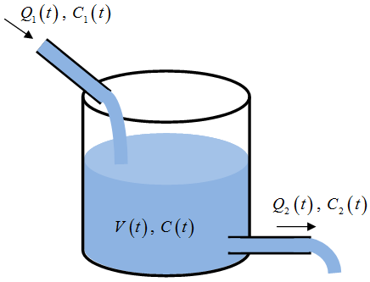
1.4 Conservation of Mass and the Mass Balance
Liquid flows into the tank:
flow rate of Q₁ m³/s.
concentration of C₁ kg/m³.
∴ mass input rate is C₁ Q₁ kg/s;
Unit for C₁ Q₁ is the product of
kg/m³ ⋅ m³/s = kg/s
∴ change of mass in time step Δt is

Slide 68
1.4 Conservation of Mass and the Mass Balance
Initial mass in the tank is M = C⋅V;
∴ change in mass is
(1.8)
(1.9)

Slide 69
1.4 Conservation of Mass and the Mass Balance
Every term in Eqn (1.9) has the unit kgs⁻¹;
Eqn (1.7) describes change in volume with time;
Eqn (1.9) gives the change in mass (and subsequently change in concentration) with time.
(1.7)
(1.9)

Slide 70
1.4 Conservation of Mass and the Mass Balance
Concept of on the resulted concentration from static mixture of liquids can be extended for the dynamic mixing at river confluence.
Eqn (1.4)
Figure 1.4 Mixing at river confluence

Slide 71
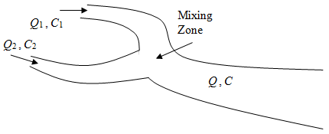
1.4 Conservation of Mass and the Mass Balance
Let:
Q₁ = flow of a matter in river;
C₁ = concentration of a matter in river;
Q₂ = flow of a matter in river tributary;
C₂ = conc. of a matter in river tributary;
Complete mixing is achieved at mixing zone.

Slide 72
1.4 Conservation of Mass and the Mass Balance
By assuming that the mixing happens in one second, Equations (1.1) and (1.4) become
With Q and C as the flow and concentration after complete mixing.
(1.10a)
(1.10b)

Slide 73


Example 1.3
A river with the flow rate Q₁ = 0.5 m³/s and chemical concentration C₁ = 2 mg/L receives an industrial effluent with the flow rate Q₂ = 0.1 m³/s and concentration C₂ = 50 mg/L. Find the flow Q and the concentration C in the river after complete mixing is achieved at mixing zone.
Mixing
zone

Slide 74
1.5 Simple River Flow
Concept of the conservation of volume can be applied to river flow to formulate the flow in simpler form;
Since the condition of a river can be different from one location to another, the river is divided into segments of length Δx;

Slide 75
1.5 Simple River Flow
To facilitate discussion, let us consider a segment of the river located between two locations, i.e. x and x + Δx;
For this small segment,
let V = volume, W = width and D = depth.
Figure 1.5 River flow

Slide 76
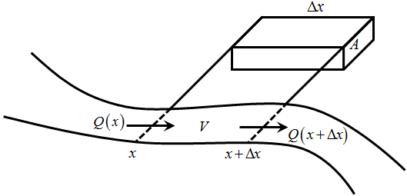
1.5 Simple River Flow
Let Q (x) m³/s = water flow at x;
Q (x + Δx) m³/s
= water flow at (x + Δx);
In time step Δt:
Q (x) ⋅Δt = amount of water that flows into the segment;
Q (x + Δx) ⋅Δt = amount of water that flows out of the segment.

Slide 77
1.5 Simple River Flow
∴ conservation of volume dictates that
(1.11)

Slide 78
1.5 Simple River Flow
Now, segment volume V = A⋅Δx
A m² = cross-sectional area;
Δx m = length of river segment;
∴
⇒ a change in volume ΔV will lead to a change in the cross sectional area ΔA.
(1.11)

Slide 79
1.5 Simple River Flow
(1.12)
By taking Δx → 0 and Δt → 0:
(1.13)

Slide 80
1.5 Simple River Flow
(1.13)
A partial differential equation (continuity equation) involving two variables Q (x, t) and A (x, t);
To complete this system, another PDE (momentum equation) is needed.

Slide 81
1.5 Simple River Flow
The momentum equation is derived from the law of conservation of momentum;
Newton’s 2nd Law:
Force = mass ⋅ acceleration F = m ⋅a [kg m s⁻²] = [kg]⋅[m/s²]
Further details available in Koh (2004);
This system of PDE derived from the laws of conservation of mass and momentum is known as hydraulics model.

Slide 82
1.5 Simple River Flow
Hydrologic model refers to a system in which the momentum equation is replaced with a simpler approximation;
Hydrologic models, in general, are easier to solve;
When certain assumptions are applied, Eqn (1.13) can be further simplified so that a complete and yet simple solution can be obtained (Koh, 2004).

Slide 83
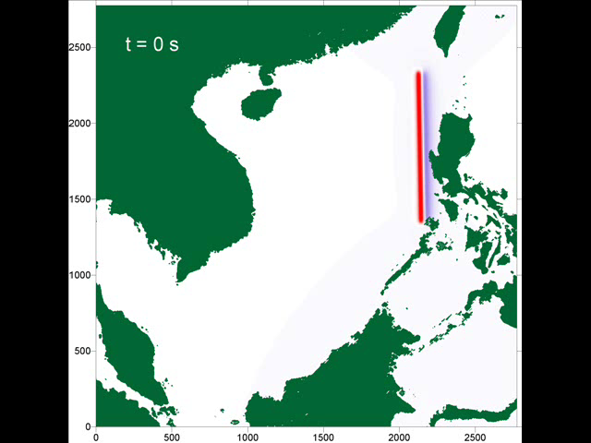
Wave Eqn

Slide 84

Thank You
for Your Attention

